Slide 1
Neuropathic pain in the rat sensorimotor cortex
Anitha Manohar
PPG Seminar - May 24th 2013

Slide 2
Introduction
Pain
Nociceptive - normal sensation of pain in response to a noxious stimulus
Neuropathic – damage or dysfunction to the nervous system
Constant sharp or burning pain often described as ‘pins and needles’ sensation.
Non-painful stimuli are now perceived as painful (allodynia)
Physiological changes through the entire neural axis
Changes in the brain
Notes:
Nociceptive – arising from a noxious stimuli , extreme temperatures or inflammed tissue. Normal pain sensation in response
Neuropathic – arising from damage or dysfunction to the nervous system , such as nerve injury
spinal cord injury, multiple sclerosis, stroke, nerve injury, lesions.
This misrepresentation of sensory information as a painful can arise due to chemical and anotomical changes throughout the entire neural axis
peripher, dorsal roots, dorsal horn – brain
Changes in the brain can be either an epiphenomena or there could be intrinsic changes in the
properties of neurons that could drive or cause this long lasting chronic neuropathic pain

Slide 3
Introduction
Evidence that central changes are not just a reflection of hyperexcitibility of neurons in the periphery
Imaging studies – existence of a “pain matrix”.
Somatosensory cortex (S1) is the ‘primary driver’ for connectivity within the pain matrix (Liu et al 2011)
Morphological changes in neurons in S1 after peripheral nerve injury (Kim and Nabekura 2011)
Increased single unit activity (spontaneous and evoked) in the VPL thalamus (Iwata M, Saab CY 2011)
Stimulation in the motor cortex has analgesic effects, (Lucas and Keller 2011)
reverses the increases in neuronal activity in the thalamus
Notes:
Check these references
Structural and anatomical changes -synaptic remodeling in S1 following peripheral nerve injury
Electrical activity recorded from the somatosensory cortex drives activity recorded elsewhere in the pain network and may bind the network together; disruption of that network by stimulation at critical sites might be used to treat pain.
Another study in 2011 by Kim and Nabekura found that there were morphological changes in the neurons in the somatosensory cortex after
PNI – This included an increase in spine density and spine turnover rate. These changes could result in an increased input drive to the cortex from other regions of the brain

Slide 4
Introduction
Abnormal sensory processing
Patients with neuropathic pain decrease in the ability to perform a two point discrimination task (Davis 2010)
How is sensory information processed by the network under conditions of neuropathic pain
Notes:
Check these references
Structural and anatomical changes -synaptic remodeling in S1 following peripheral nerve injury
Stimulation in the motor cortex has analgesic effects. And more importantly this stimulation also temporarily revereses the neuronal hyperexcitability in the sensory regions such as thalamus, S1 etc.
At the same time we also know of cases where patients have a decreased ability to perform two point discrimination tasks – indicating deficits in their sensory processing
There appears to be an interplay between sensory processing and increased activity in the motor cortex. This was my main motivation to study the sensorimotor overlap region in the rat’s hindlimb cortex under conditions of neuropathic pain

Slide 5
Motivation
Is activity of neurons in the sensorimotor cortex altered?
Changes in activity of neurons in the motor cortex during awake sensorimotor processing
To understand how sensory information is encoded in the cortex and how this is altered under conditions of neuropathic pain.
Notes:
or spatial resolution for sensory stimuli.

Slide 6
Outline
Methods
Injury model
Behavior pain testing
Chronic microwire implantation
Anesthetized and Awake experiments
Receptive Field Measures
Results

Slide 7
Outline
Methods
Results
Anesthetized experiments
Receptive Field measures
Sham Animals
Between groups
Awake experiments
Receptive Field measures
Sham Animals
Between groups
Information encoded about stimulus location
Measure used to quantify information
Sham Animals
Between groups

Slide 8
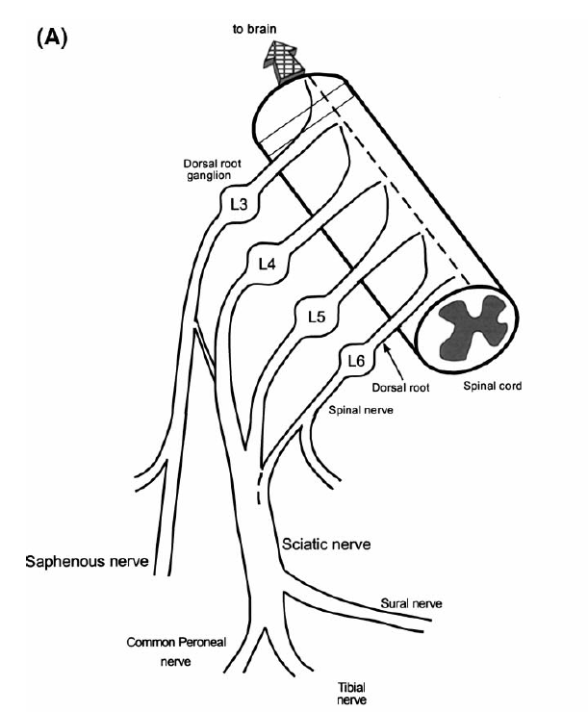
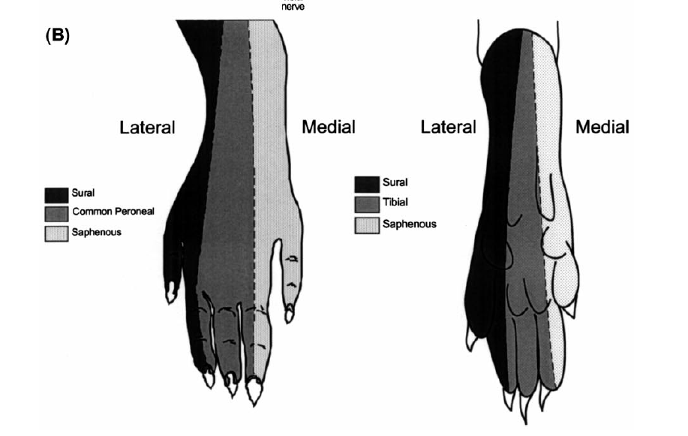
Methods: Spared Nerve Injury
DORSAL
PLANTAR
Boundary of de-afferented region
Adapted from Decosterd and Woolf 2000

Slide 9
Methods
Two groups of animals
SNI – Spared nerve injured rats (n=6)
SHAM – Sham operated rats (n=5)
Tested for mechanical allodynia
Paw Withdrawal Threshold (g)
**
**
0
1
3
7
14
21
Days after surgery
Notes:
Following surgery these animals were tested for mechanical allodynia. Animals were placed on a wire mesh and tested by mechanical stimulation of the hindpaw using vonfrey filaments. The threshold for paw withdrawal in response to stimulation using vonfrey hairs signifcantly reduced for SNI animals compared to Sham animals. SNI animals withdraw their paw even for stimulation using non-painful or innocuous stimuli. All animals used in this study exhibit mechanical allodynia.

Slide 10
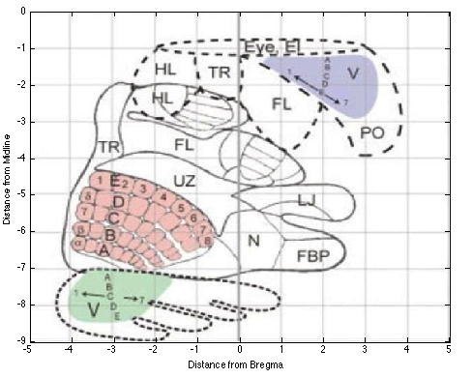
Methods
Microwire Implantation
3-4 weeks after SNI/Sham surgery
Implanted with 16 channel microwire array electrodes
Bilaterally in the hindlimb sensorimotor cortex
Infragranular layers V/VI.
Leergard et al 2004
Notes:
Make a grid of 16 electrodes

Slide 11
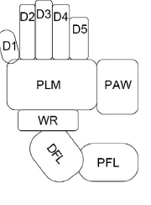
Methods
Sensory stimulation of the hindlimb
Animal is lightly anesthetized
Nembutal (35 mg/kg)
Frieburg Stage III, responds to toe pinch
9 discrete locations stimulated 100 times each
Light Touch (no skin indentation)
Strong Touch (60g calibrated using vonFrey filament)
Paw

Slide 12
Methods
Awake experiments
Activity of neurons recorded while the animal is walking on a treadmill
Smooth surface
Rough surface
Gait of the animal was videotaped
Times when the hindpaw contacted
the treadmill extracted from the video

Slide 13
Receptive Field Measures
Spontaneous firing rate
Latencies
Time to First bin (FBL)
Time to Last bin (LBL)
Time to Peak bin (PBL)
Response Magnitude (RM)
# spikes between
first and last bin
Peak of the response (PR)
# spikes in the peak bin
Response Duration
(LBL-FBL)
Receptive Field Size (RFS) = # locations a single neuron responds to.
FBL
LBL
Notes:
* Show these on the figure !

Slide 14
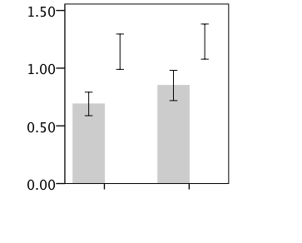
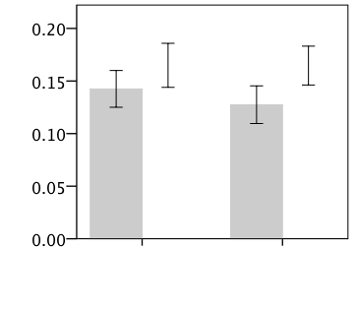
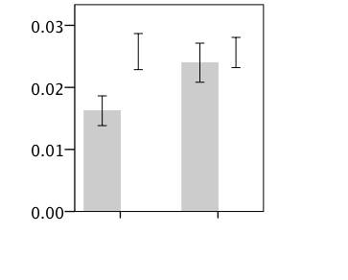
Anesthetized
Response Magnitude
(spikes/trial)
Light
Strong
Light
Strong
**
Peak Response
(spikes/trial)
Response Duration (sec)
Light
Strong
Light
Strong

Slide 15
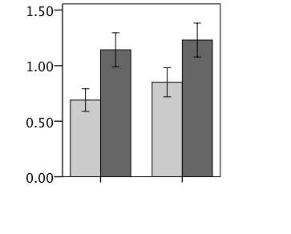
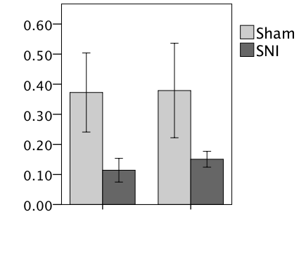
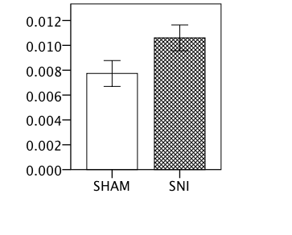
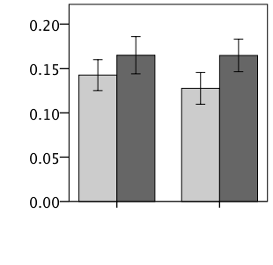
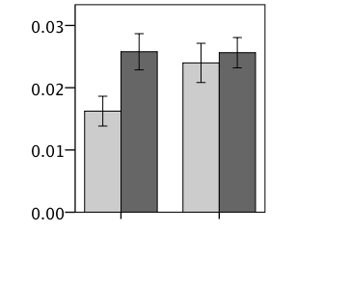
Anesthetized
**
**
Background Activity
**
Response Magnitude
(spikes/trial)
Light
Strong
**
Peak Response
(spikes/trial)
Response Duration (sec)
Light
Strong
Light
Strong

Slide 16
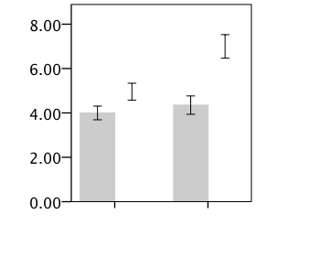
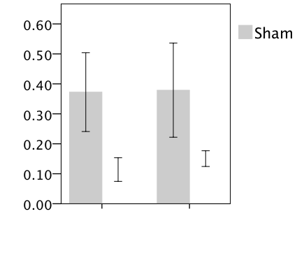
Receptive Field Size
Paw
Light
Strong
For Sham, no differences in the size of the receptive field for the light and strong stimuli

Slide 17
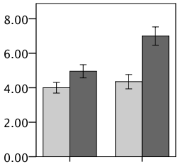
**
Receptive Field Size
**
Paw
Light
Strong
For Sham, no differences in the size of the receptive field for the light and strong stimuli
Size of the receptive field of neurons of SNI rats is larger than those of SHAM

Slide 18
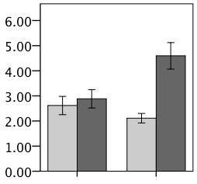
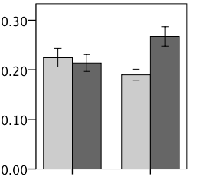
Treadmill Awake Recordings -
Awake
SHAM
SNI
Smooth
**
Background Activity
Rough
Peak Response (spikes/trial)
**
**
Response Magnitude
**
Response Duration (ms)
Smooth
Rough
Smooth
Rough
Smooth
Rough
Notes:
** Do sham first

Slide 19
Results - Summary
Neurons in the Sham animals respond for a longer duration for a painful stimulus
Neurons in SNI animals have higher spontaneous firing rate (awake and anesthetized states)
SNI animals show increases in neuronal responsiveness
Light stimuli
Strong stimuli
SNI animals show enhanced motor responses during locomotion on the treadmill with a rough surface

Slide 20
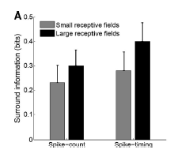
Processing Sensory Information
Receptive Field of a neuron
Paw
Foffani and Moxon 2008

Slide 21
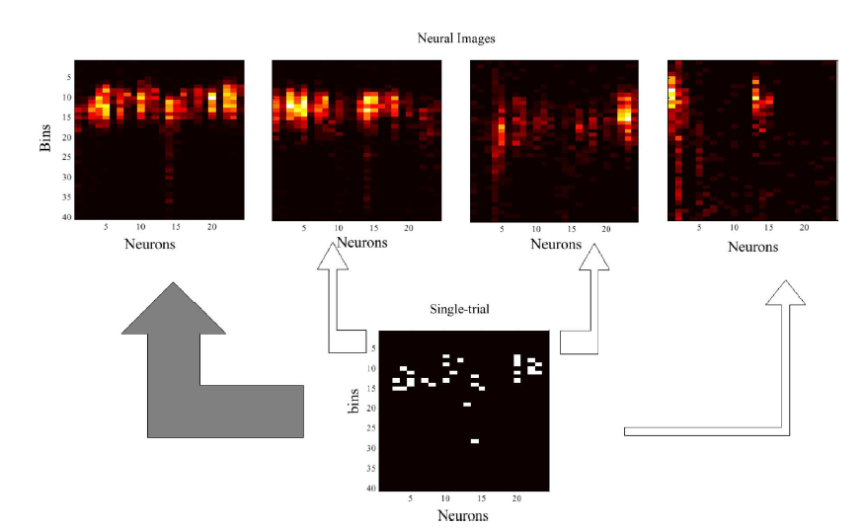
Information encoded about stimulus location
Spikes/ trial
bins
Paw

Slide 22
Paw
 | Predicted D1 | Predicted D2 | ….
Actual D1 | P(R1|D1) | P(R2|D1)
Actual D2 | P(R1|D2) | P(R2|D2)
..
Shannon’s mutual information formula

Slide 23
Information (bits)
Light
Strong
SHAM animals - No differences in the amount of information about stimulus location for a light or strong touch

Slide 24
**
Information (bits)
Light
Strong
Information about location of the stimulus is reduced for SNI animals inspite of higher responses
The results potentially explain a neuronal mechanism for loss of spatial resolution and discriminability for patients with neuropathic pain

Slide 25
Response
Response
Distance from RF center
Distance from RF center

Slide 26
Conclusions
Neurons in the sensorimotor cortex of rats with neuropathic pain show
Increases in their spontaneous firing rate during awake and anesthetized conditions
Increases in responses to sensory stimulation of the hindpaw under anesthesia
Increases in motor responses during sensorimotor stimulation by a rough surface in awake state.
Enlargement of receptive field size and suggested potential changes in the structure of the RF
Decrease in the sensory information encoded by neurons about stimulus location for animals exhibiting neuropathic pain

